Slide 1
SIMULATING
INTELLIGENT PERSONAL ASSISTANTS
BY
AMBIENT INTELLIGENCE

Slide 2
WHAT IS AMBIENT INTELLIGENCE?
Ambient - environment around us.
Thus,
Developing A Intelligent Environment By Ambient Intelligence And Simulating It by IPA’s / Virtual Assistants.

Slide 3
CONCEPTS INVOLVED
PERVASIVE COMPUTING
Pervasive Computing Creates Environment With Full And Integrated Internet Connectivity.
The Goal Of Pervasive Computing, Is To Combine Current Network Technologies With Wireless Computing, Voice Recognition, Internet Capabilities, Etc…
UBIQUITOUS COMPUTING
Ubiquitous Computing Is The Creation Of Smart Products That Are Connected, Making Communication And The Exchange Of Data Easier And In Less Obtrusive Manner.
Computing Is Made To Appear Anytime And Everywhere

Slide 4
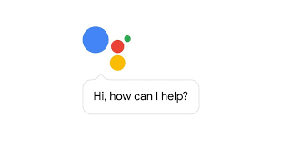
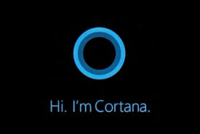
MOTIVATION
We have seens things like
Google-Assistant Microsoft -Cortana
“ We Want The System To Know Us More”
So ,We Developed A Customizable Virtual Assistant Especially For end user.
1

Slide 5
TECHNICAL - GRAZ UP’S
So , Basically It's A Voice Based Interactive System Which Is Developed In Python Programming Language.
It Has An Integral Part Of Speech Recognition , Computation And Information Retrieval System.
2

Slide 6
PACKAGES USED
Speech_recognition
Win32com.client
Nltk
Pymysql.cursors
Wikipedia
Wolframalpha
3

Slide 7
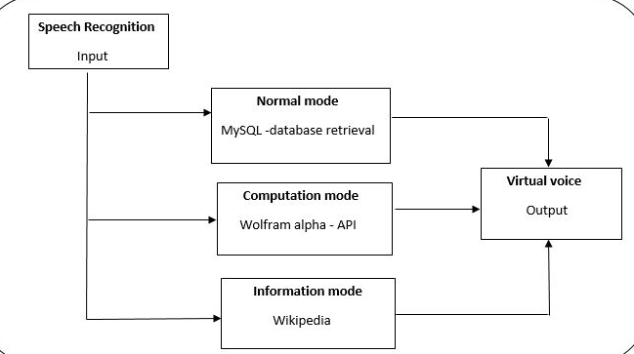
FLOW ARCHITECTURE:
4

Slide 8
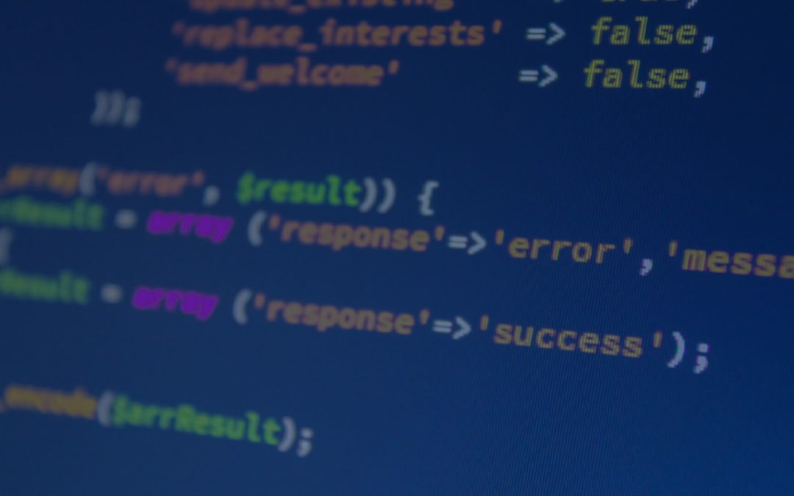
Implementation

Slide 9
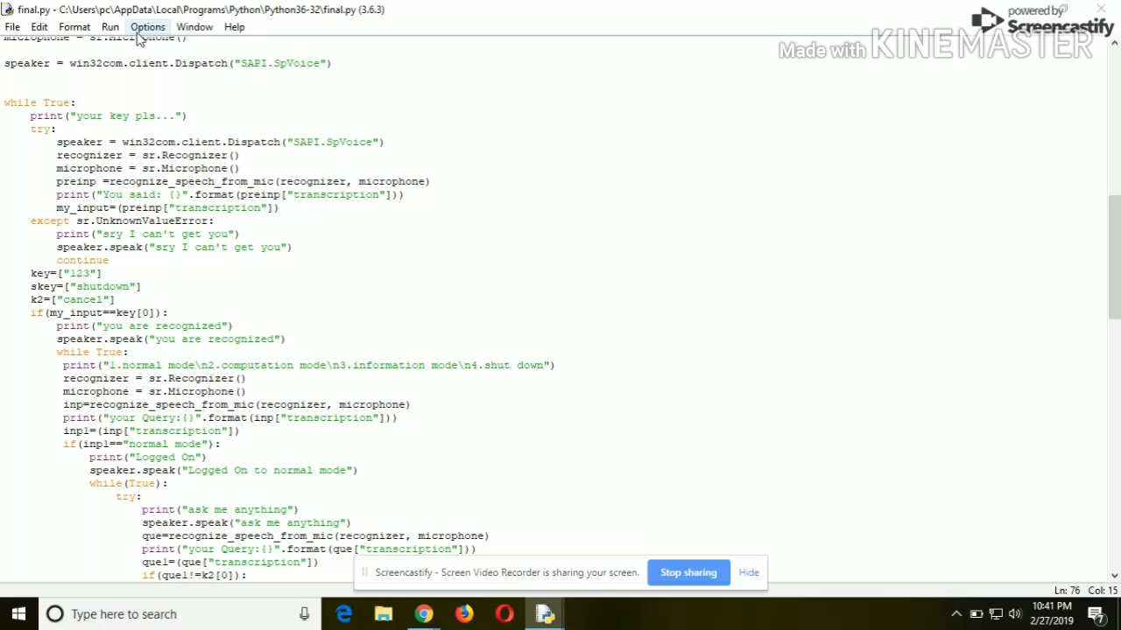
5

Slide 10
Video link

Slide 11


FINAL PRODUCT -SOFTWARE
Or
As raw Python program
An Android
Web Application

Slide 12
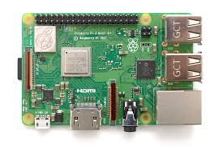
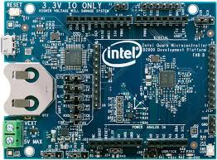
FINAL PRODUCT -HARDWARE
Raspberry Pi -For Smaller Communities
Intel Board-For Larger Communities

Slide 13
ADVANTAGES:
Customizable
User-friendly
Low End
Highly Secure

Slide 14
DIFFICULTIES WE FACE:
Large Implementations Need More Hardware Support.
It Can Be Resolved By Using High End Hardware.

Slide 15
REFERENCES:
Hagras, H., V. Callaghan, et al. (2004). &quot;Creating an Ambient-Intelligence Environment Using Embedded Agents.&quot; IEEE Intelligent Systems 19(6): 12-20.
Da Costa, O. and Y. Punie (2003). Ambient Intelligence in Everyday Life: Everyday Life Research Network. London.
Amigoni, F., N. Gatti, et al. (2005). What Planner for Ambient Intelligence Applications.
Aarts, E. (2004). &quot;Ambient Intelligence: A Multimedia Perspective &quot.
Ramos, &quot;Ambient Intelligence—a State of the Art from Artificial Intelligence Perspective.
5.N. Shadbolt, &quot;Ambient Intelligence,&quot; IEEE Intelligent Systems,vol. 18, no. 4, 2003, pp. 2–3.
Riva, G., P. Loreti, et al. (2003). Presence 2010: The Emergence of Ambient Intelligence. Being There: Concepts, Effects and Measurement of User Presence in Synthetic Environments. G. Riva,
F. Davide and W. A. Ijsselsteijn Amsterdam, The Netherlands, IosPress.
Skordas, T. and G. Metakides (2003). &quot;Major Challenges in Ambient Intelligence.&quot; Studies in Informatics and Control 12(2): 85-89.

Slide 16
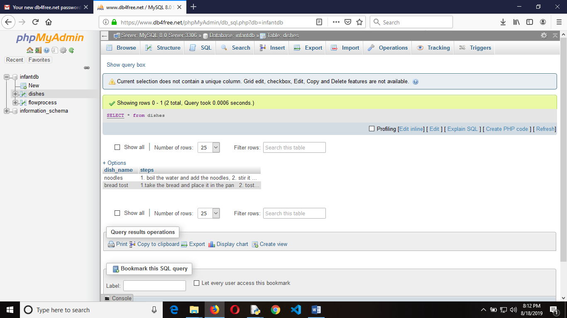

Slide 17
THANKS!
Infant Raju R
Naveen Kumar V G

